Slide 1
News Headline Classification Using Logistic Regression & BiLSTM (Glove Embeddings)
(NEWTON AI Project - 01)
Prepared By – Advait Tandel
Dataset – Huff-Post News Dataset
Tech Stack: Python, Scikit-Learn, TensorFlow/Keras, NLTK, SpaCy, GloVe
Objective - Build and compare text classification models for news headlines.

Slide 2
Introduction
This project aims to build an end-to-end text classification system that categorizes news headlines into their correct article sections.
We implement two full pipelines:
TF-IDF + Logistic Regression (Classic ML Baseline)
Bidirectional LSTM + GloVe (Deep Learning Model)
A detailed comparison is performed to determine which approach best handles real-world headline classification.

Slide 3
Agenda
Problem Statement
Project Scope
Dataset Description
Data Preprocessing
LR: TF-IDF Feature Engineering
Logistic Regression Model
LSTM: Text Cleaning + Features
LSTM Architecture
Evaluation Metrics
Results Summary (Base vs Tuned)
Confusion Matrix Insights
Visualizations
Model Comparison
Future Improvements

Slide 4
Problem Statement
News websites generate massive amounts of headlines every day. Manual classification into categories is:
• Slow • Error-prone • Not scalable
Objective: Build automated text classification models that classify headlines into categories like: → Politics → Business → Entertainment → Sports → Technology → Others

Slide 5
Project Scope
This is a complete NLP lifecycle project:
✔ Load & Explore HuffPost dataset ✔ Data cleaning & missing value handling ✔ Combine headline + short description + full description ✔ Build baseline TF-IDF + Logistic Regression model ✔ Hyperparameter tuning using GridSearchCV ✔ Build Bidirectional LSTM with Glove embeddings ✔ Implement Random Search tuning ✔ Evaluate both models ✔ Confusion matrix & visualizations ✔ Save models for deployment

Slide 6

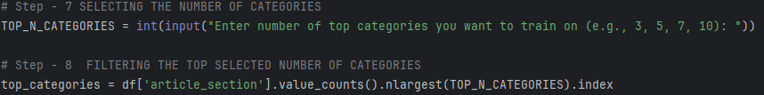
Dataset Description
File Used: huffpost_news_data.csv
Columns selected:
Headline
short_description
Description
article_section
A new combined column is created: text = headline + short description + description
We use Top N categories (chosen by user input).
The Shape of Data set used for classifying was (5443, 5).
Training Set Size: 1918
Test Set Size: 480
We are working on 5 categories here :

Slide 7
Data Preprocessing
Both models follow a consistent cleaning pipeline:
Steps performed:
Filling missing values
Lowercasing
Removing special characters
Tokenization
Stopword removal (NLTK)
Lemmatization
Added Sentiment flag (positive/neutral/negative)
Extracted keyword phrases using SpaCy noun chunks
Final combined processed text: ( final_text = clean_text + sentiment + keywords)
This creates richer semantic inputs for LSTM.

Slide 8

LR: Feature Engineering (TF-IDF)
TF-IDF vectorization is applied to cleaned text.
This method:
Converts text into numerical vectors
Captures word importance
Works well with short text
Used as input for Logistic Regression.

Slide 9

Model – 01 Logistic Regression + tfidf
Base Logistic Regression Accuracy: 0.8625 ~ 86.3%
Trained on:
Cleaned text
TF-IDF vectors
Top categories only
Hyperparameter Tuning
Using GridSearchCV:
C: [0.1, 1, 3] Best Logistic Regression Accuracy + GRID SEARCH : 0.8792 ~ 88%.
Solver: [lbfgs, saga]
max_iter: [500, 1000]
Best model saved as: best_lr, pkltfidf_vectorizer.pkl, label_encoder.pkl
Best Paramters :

Slide 10
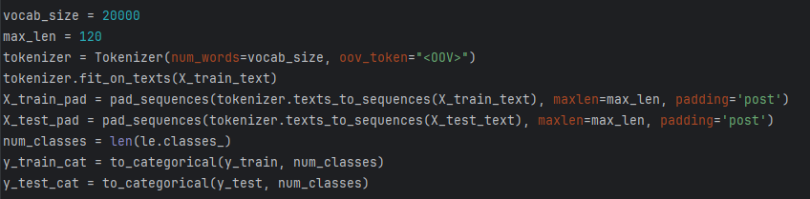
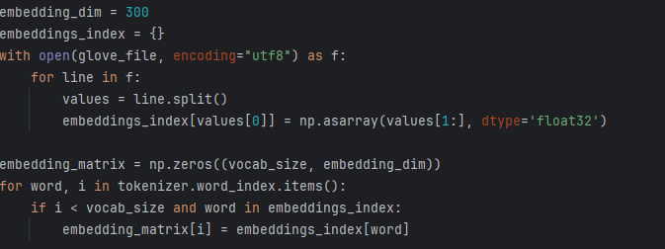
Model – 02 LSTM : Text Cleaning + Embedding Setup
Additional LSTM-specific features added:
Sentiment polarity using Text-Blob
Keyword extraction via SpaCy
Lemmatization + Stopword removal
Tokenization & Padding:
Word Embeddings:
Downloaded Glove 300D and built an embedding matrix:
Baseline LSTM Accuracy: 0.7937 ~79.4%.
param_grid for tuning = {lstm_units: [96, 128, 160, 192], dropout: [0.2, 0.3, 0.4],lr: [1e-4, 3e-4, 5e4],batch_size: [64, 96,128]}
Tuned LSTM Accuracy :0.8271 ~82.7%.
Best Paramters :

Slide 11
Model – 02 LSTM : Architecture
The deep learning model consists of:
1) Embedding Layer
Preloaded Glove vectors
Trainable for fine-tuning
2) Bidirectional LSTM (128 units)
Learns context both forward + backward
Handles long-term dependencies
3) Dense Layers + Dropout
Improves generalization
4) Output Layer
Softmax activation for multi-class classification
Optimizer & Training
Adam Optimizer
Early Stopping callback
8 epochs for base model

Slide 12
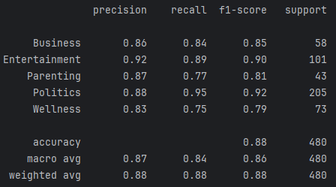
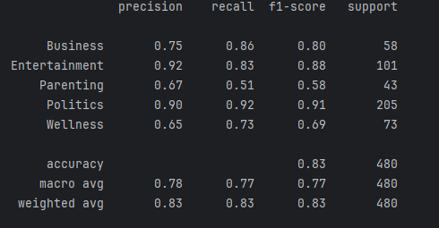
Evaluation Metrics
Both models evaluated using:
Accuracy
Precision
Recall
F1 Score
Confusion Matrix
For Logistic Regression tuned the Metrics
For LSTM tuned the Metrics

Slide 13
Results Summary (Your Actual Model Performance)
Logistic Regression
Baseline Accuracy: 86.25%
After GridSearch: 87.92%
Works very well for high-frequency keywords
BiLSTM + GloVe
Base Model Accuracy: 79.37%
Tuned Model Accuracy: 82.71%
Expected outcome from your script:
Logistic Regression(Tuned)> Logistic Regression(Base) > LSTM (tuned) > LSTM (base)

Slide 14
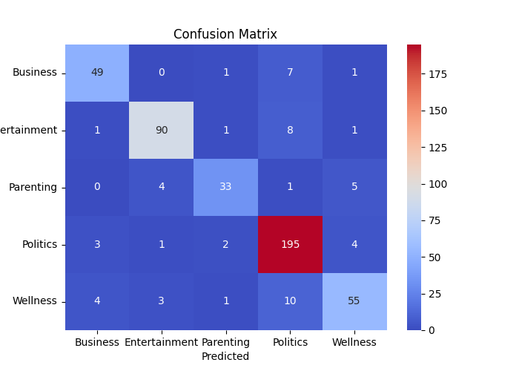
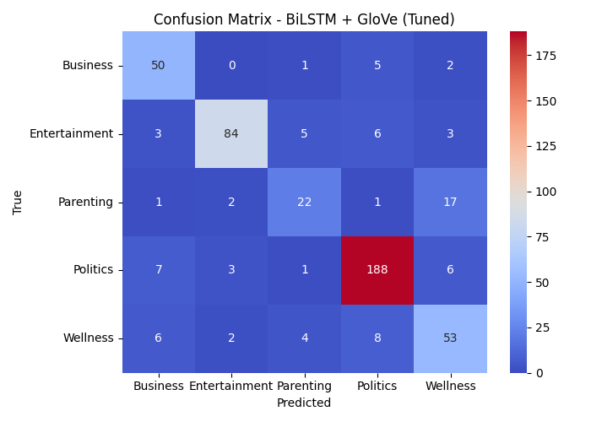
Confusion Matrix Insights
Logistic Regression Confusion LSTM Confusion:

Slide 15
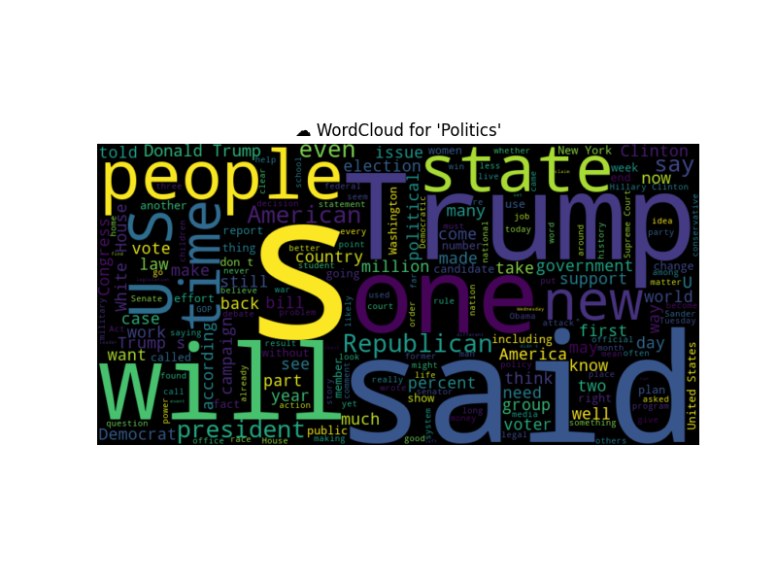
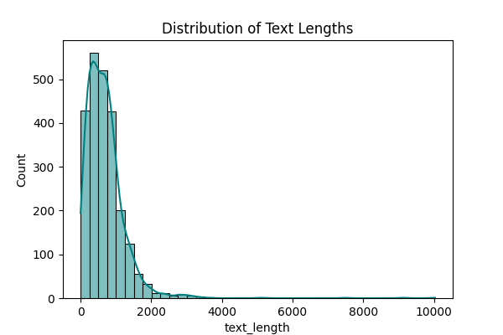

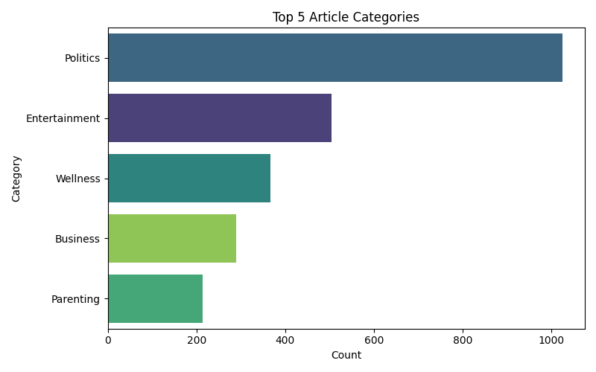

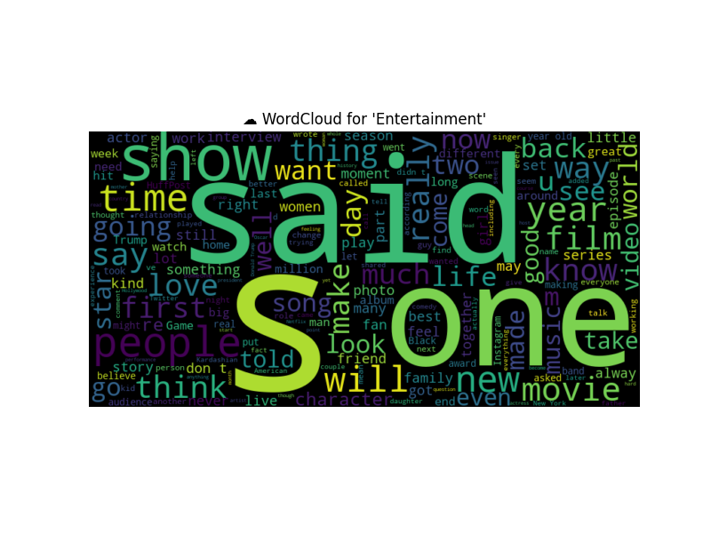

Visualizations
From Logistic Regression Code:
Category distribution
Text length distribution
Word clouds per category

Slide 16

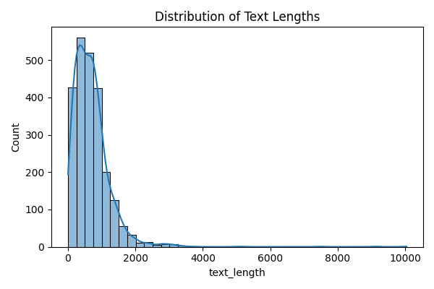
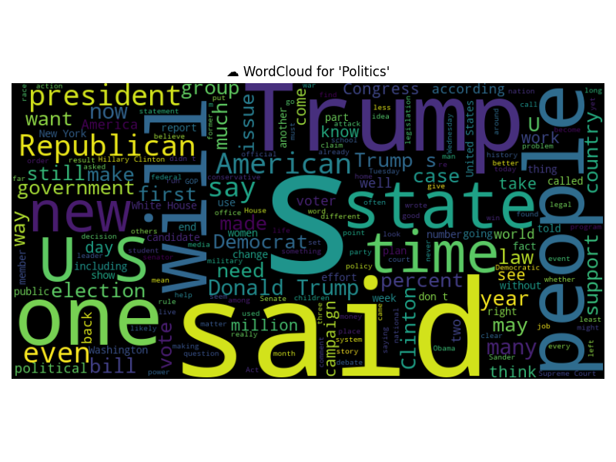
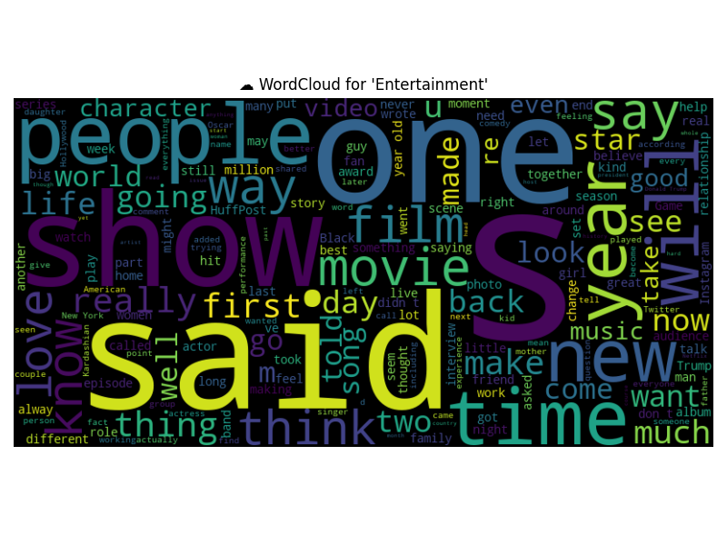


Visualizations
From LSTM Code:
Category distribution
Text length distribution
Word clouds per category

Slide 17
Model Comparison
Types of Model | Accuracy %
Logistic Base Model | 86.25%
Logistic Grid Search(Tuned) | 87.92%
Lstm + Glove Base Model | 79.37%
Lstm + Glove Grid Search (Tuned) | 82.71%
Conclusion -The tuned Logistic Regression model outperformed all other models with an accuracy of 87.92%. Despite using advanced deep learning (LSTM + GloVe), classical machine learning proved more effective for short-text classification in this project.

Slide 18
Future Improvements
To further enhance the model:
🔹 Use BERT / RoBERTa / Distil BERT 🔹 Add multi-label support 🔹 Improve category balancing 🔹 Build a real-time REST API 🔹 Deploy using Docker + Fast API 🔹 Create model monitoring dashboards

